Slide 1
Wind Energy Market in the US

Slide 2
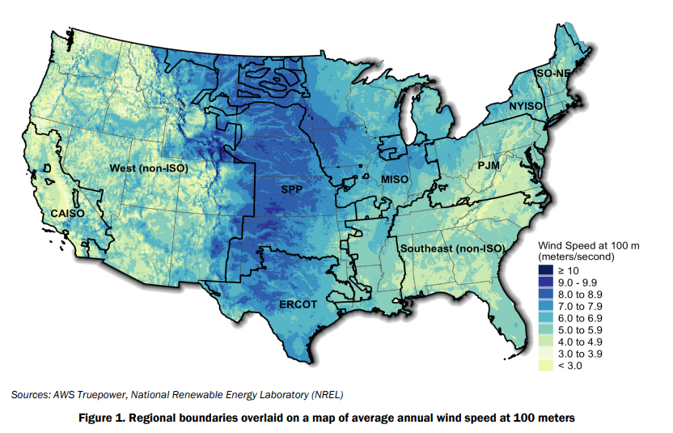
Energy Market in the US
The US energy market is divided into 10 sub-regions, with each being governed by an energy operator that manages the electricity grid and wholesale electricity markets in that region.
There are:
California Independent System Operator (CAISO)
Electric Reliability Council of Texas (ERCOT)
Midcontinent Independent System Operator (MISO)
ISO New England (ISO-NE)
New York Independent System Operator (NYISO)
PJM Interconnection (PJM)
Southwest Power Pool (SPP)
Southwest Power Pool - West (SPP West)
Western Electricity Coordinating Council (WECC)
Nearly 75% of the new wind capacity installed in 2021 is located in ERCOT, MISO and SPP.

Slide 3
Installation Trends of Wind Turbine in US
A relatively new trend is that of partial wind project repowering, in which major components of turbines are replaced. Such efforts provide access to favorable tax incentives, increase energy production with more advanced turbine technology, and extend project life.
In addition to the newly installed capacity, 1.6 GW of existing wind plants were partially repowered in 2021, mostly in the form of increased rotor diameters and the replacement of major nacelle components; this is a decline from the previous two years, when roughly 3 GW were retrofitted each year.
Why was there decline in 2021?
Supply chain pressures, policy uncertainty, and interconnection delays, which together reportedly caused 5 GW of wind projects previously planned for completion in 2021 to slip to later years.

Slide 4
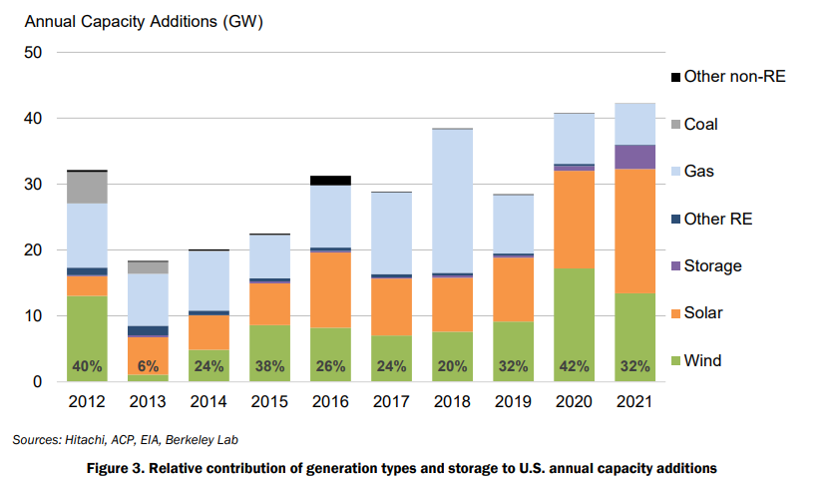
Comparison with other energy sources
Solar energy is the biggest contender for wind energy.
Wind power has comprised a sizable share of capacity additions in recent years. In 2021, it constituted 32% of all U.S. generation and storage capacity additions, second only to solar power at 45%.
Natural gas and other non-renewable capacity additions continued their recent decline, falling to their lowest level in more than 20 years

Slide 5
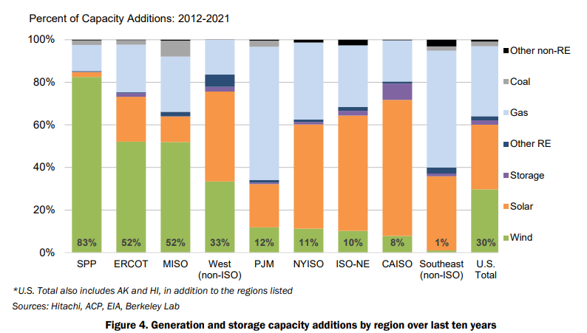
Capacity growth of wind energy among the US energy market sub-regions
Wind energy achieved the biggest capacity growth in the SPP, ECROT and MISO regions, consistent with the concentration of wind speed in the pervious graph.

Slide 6
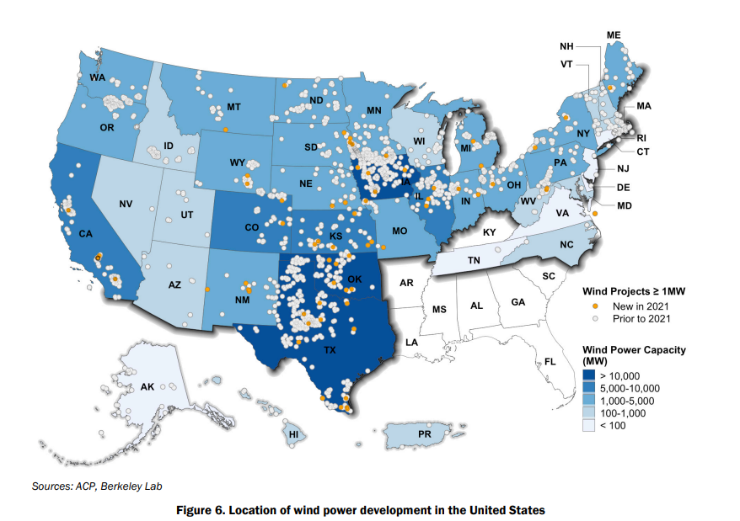
Wind power capacity by states

Slide 7
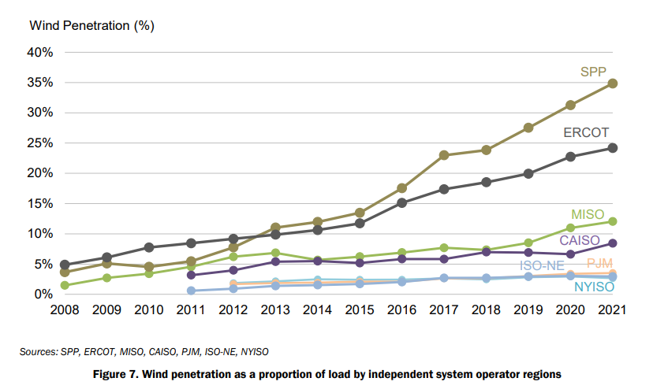
Wind penetration by energy market sub-regions
Wind penetration = percentage of electricity generated by wind power over total electricity demand in a given system or grid.
For example, if a region has a total electricity demand of 1000 megawatts (MW) and wind turbines generate 200 MW of electricity, the wind penetration would be 20%.
Wind penetration levels can vary depending on factors such as the availability and capacity of wind resources, the level of demand, and the capacity of the transmission infrastructure to handle the fluctuations in electricity supply from wind turbines.

Slide 8
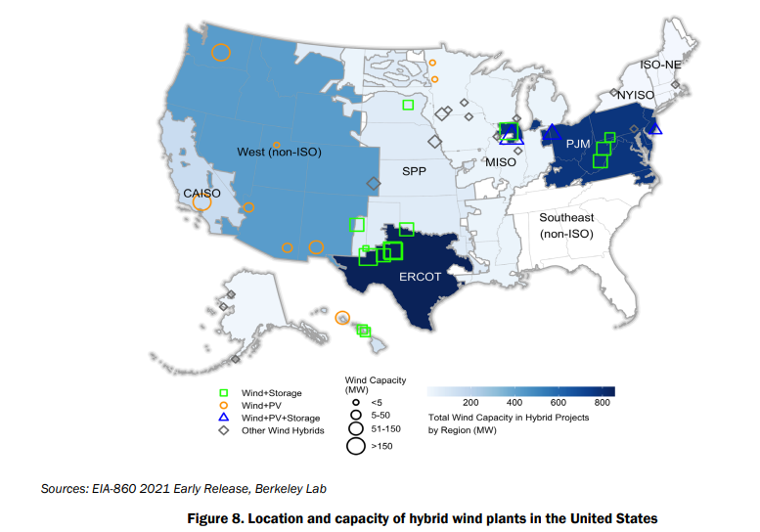
Hybrid Wind Plants
A wind hybrid project is a renewable energy project that combines wind power with one or more other sources of energy, such as solar power, battery storage, or a backup generator.
The goal of a wind hybrid project is to increase the efficiency and reliability of the overall energy system. For example, a wind-solar hybrid system can provide a more stable supply of electricity by balancing the intermittent output of wind turbines with the more predictable output of solar panels.
A wind-battery hybrid system can store excess wind power for use during times of low wind generation. This is the most common type of wind hybrid project, where 1.4 GW of wind has been paired with 0.2 GW of battery storage across 14 plants. However, no new projects of this type were installed in 2021.

Slide 9
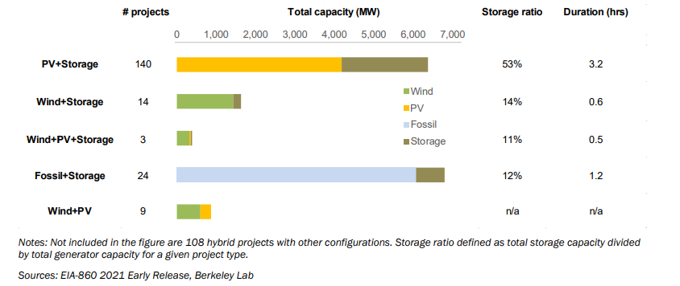
Limitations of wind + storage hybrids
Wind + storage hybrids have a 14% storage-to-generator ratio with an average storage duration of just 0.6 hours, suggesting a focus on providing ancillary services and only
limited capacity to shift large amounts of energy across time.
The storage-to-generator ration is much lower compared to solar energy (PV), which also has a bigger edge over wind in terms of the duration of storage.
Based on data from proposed
projects, there is growing interest in hybridizing with larger storage-to-generator ratios and longer storage durations

Slide 10
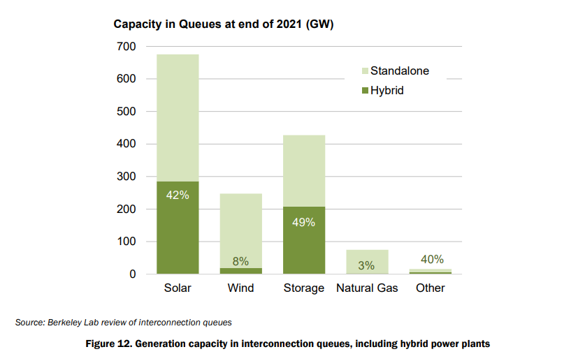
Transmission Interconnection Queues for wind energy vs other energy sources
One testament to the amount of developer and purchaser interest in wind energy is the amount of wind power capacity working its way through the major transmission interconnection queues across the country
The interconnection queue is essentially a waiting list of new energy projects that are seeking to connect to the transmission system. The queue is managed by the transmission operator or system operator, who reviews each project's application and determines its feasibility and priority for interconnection. The process can take several years, as there may be a large number of projects in the queue, and the studies and assessments required can be complex and time-consuming.
the amount of wind capacity in the nation’s interconnection queues provides some indication of the amount of developer interest

Slide 11
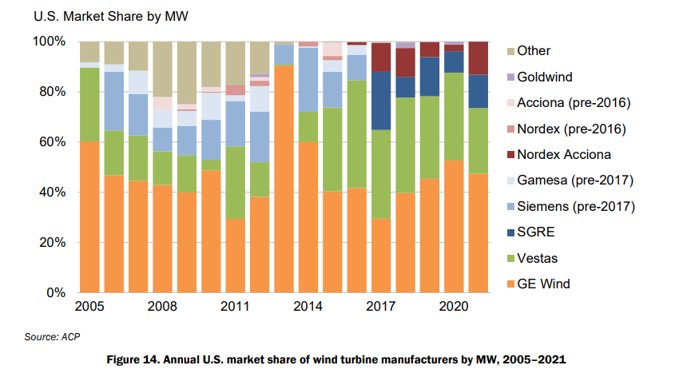
US Market Share of Wind Turbine Manufacturers
Just four turbine manufacturers, led by GE, supplied all of the U.S. wind power capacity installed in 2021

Slide 12
Domestic supply vs demand
The domestic manufacturing capability for towers and nacelle assembly remains reasonably well balanced with projected wind additions in the United States, but that blade manufacturing capability has fallen well below near-term wind additions as international suppliers outcompete domestic ones.

Slide 13
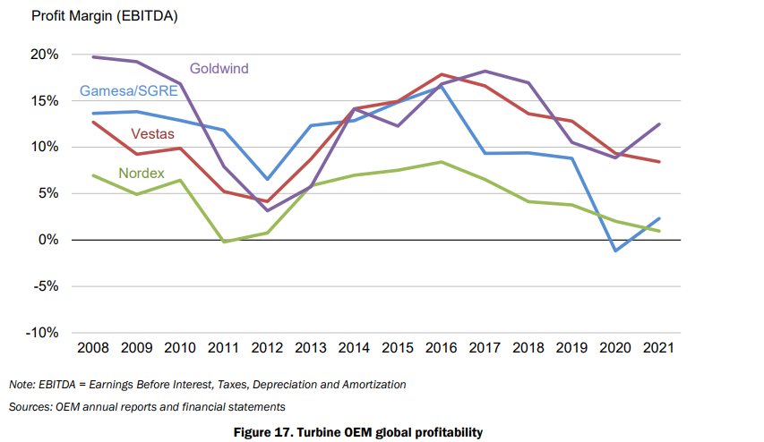
Falling profit margin for wind turbine manufacturers
fierce competition among manufacturers has generally reduced turbine OEM profitability over the last several years. High recent commodity and transportation costs along with COVID-19 restrictions have also limited manufacturer profitability

Slide 14
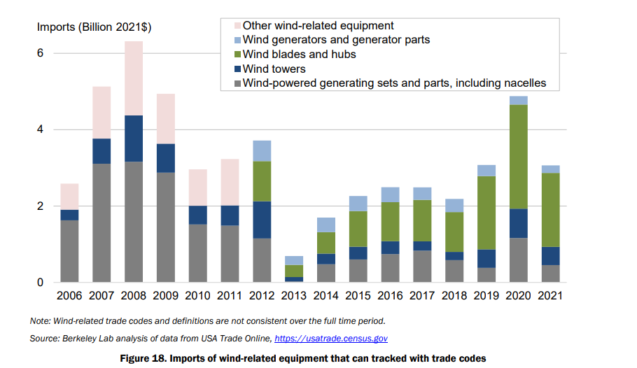
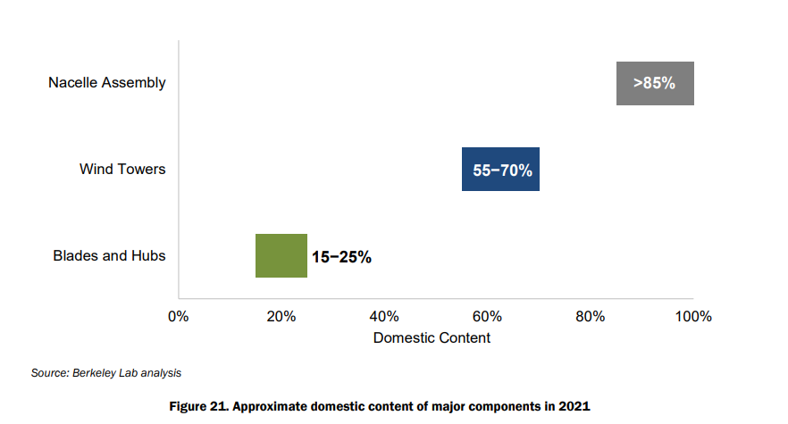
Imports are essential for wind turbine manufacturing
Despite the breadth of the domestic wind industry supply chain, the U.S. wind sector is reliant on imports of wind equipment. The level of dependence varies by component: some components have a relatively high domestic share, whereas others remain largely imported.

Slide 15
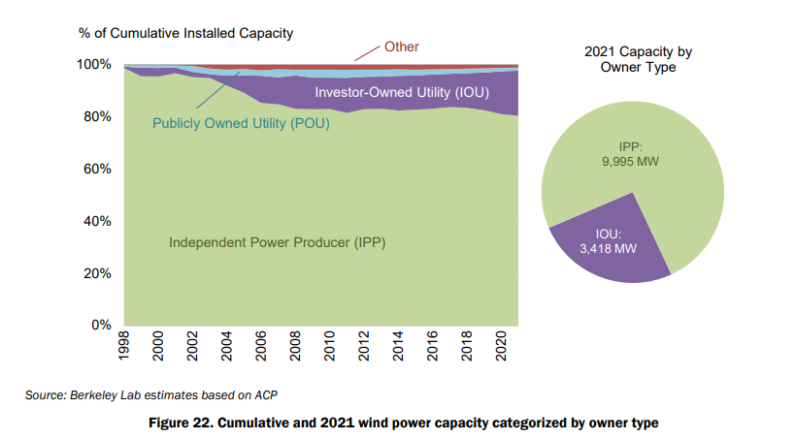
Wind Power Producers in the US
Independent power producers (IPPs) own 75% of the 13.4 GW of new wind capacity installed in the United States in 2021 (right pie chart).
Investor-owned utilities (IOUs)—most notably Pacificorp (589 MW), AEP’s PSO and SWEPCO (486 MW), the Empire District Electric Company (450 MW), and Xcel Energy (436 MW), but including ten IOUs in all—installed a total of 3,418 MW (25%).
Of the cumulative installed wind power capacity at the end of 2021, IPPs own 80% and utilities own 18% (17% IOU and 1% publicly owned utility, or POU), with the remaining 1% falling into the “other” category of projects owned by neither IPPs nor utilities (e.g., owned by towns, schools, businesses, farmers).

Slide 16
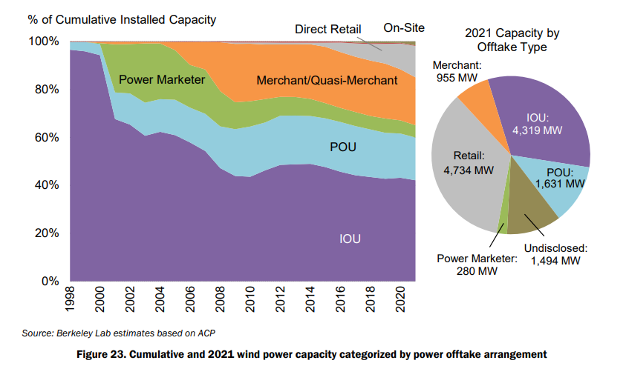
Power offtake arrangement for wind power
A power offtake arrangement refers to an agreement between a power generator (often a renewable energy developer) and a purchaser or off-taker of the electricity produced.
Under a power offtake arrangement, the generator agrees to sell and the off-taker agrees to buy the electricity generated by the power plant for a specified period and at a predetermined price.
Power offtake arrangements can take several forms:
power purchase agreements (PPAs), which are long-term contracts that typically run for 10-20 years
virtual power purchase agreements (VPPAs), which allow off-takers to purchase renewable energy credits (RECs) that correspond to a portion of the energy generated by a specific renewable energy project.

Slide 17
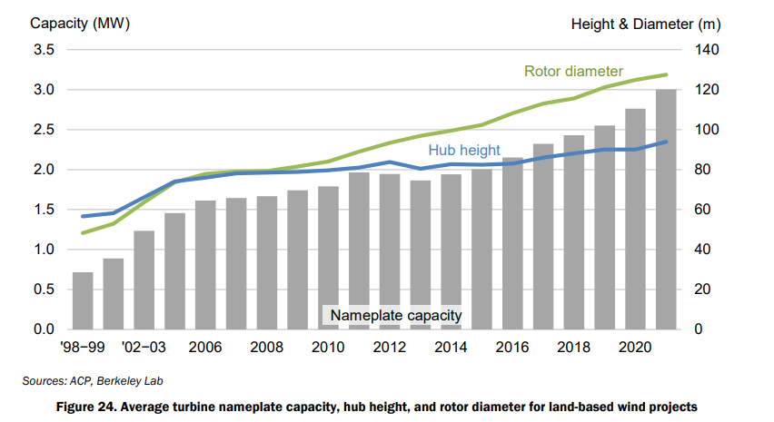
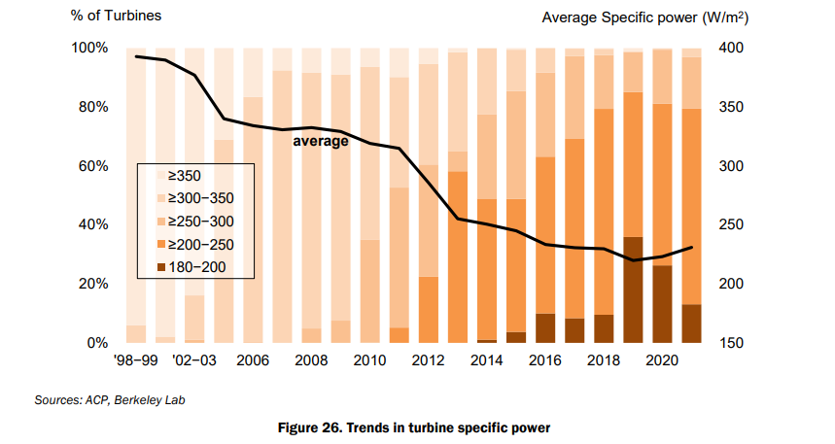
Wind Turbine Technology Trends
In summary, the wind turbine technology in the US exhibits the following trends over time:
Taller hub height
Larger rotor diameter
Larger turbine capacity
Lower average specific power
a lower specific power will boost capacity factors, because there is more swept rotor area available (resulting in greater energy capture) for each watt of rated turbine capacity.
In general, turbines with low specific power were originally designed for lower wind speed sites, intended to maximize energy capture in areas where large-rotor machines would not be placed under excessive physical stress due to high or turbulent winds.

Slide 18
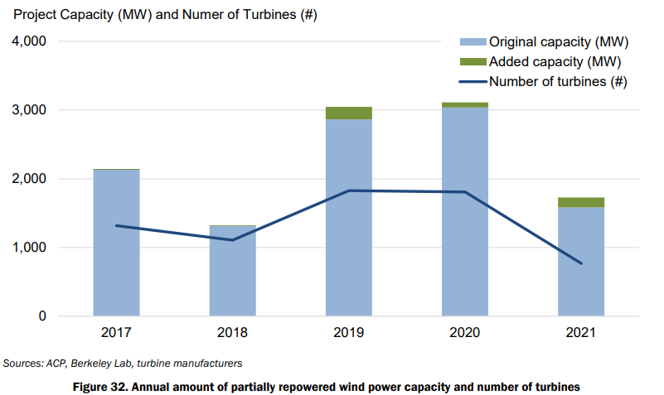
Retroffited Wind Turbines
The trend of partial wind project repowering continued in 2021, albeit at a slower pace, and involved replacing major components of turbines with more-advanced technology to increase energy production, extend project life, and access favorable tax incentives.
In 2021, 12 projects were partially repowered, involving 769 turbines that totaled 1.6 GW prior to repowering.
Retrofitted turbines ranged in age from 9 to 16 years old; the median was 10 years. The 1.6 GW of retrofitted turbines in 2021 is a decline from the previous two years, when roughly 3 GW were retrofitted each year

Slide 19
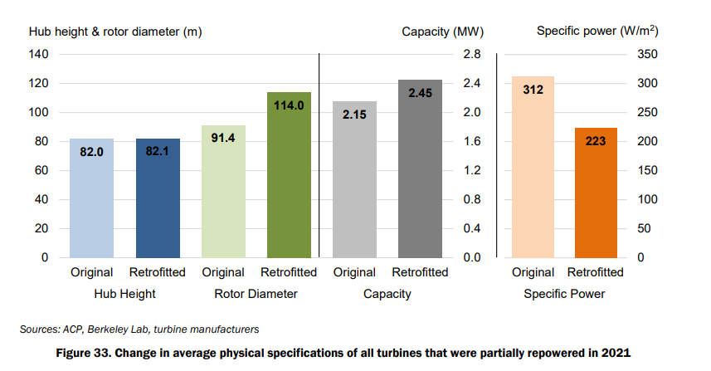
Technology trends for retrofitted wind turbines

Slide 20
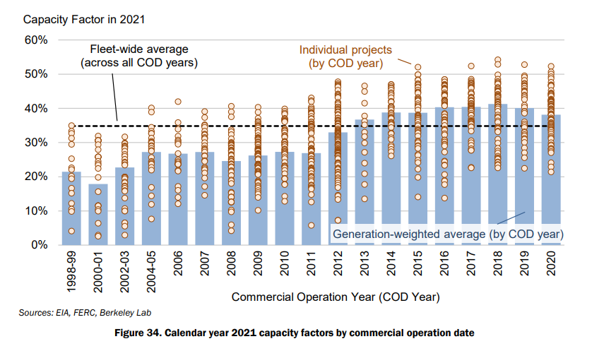
Capacity Factor of Wind Turbine Projects
Capacity factor is a measure of the actual energy generated by a project over a given timeframe relative to the maximum possible amount of energy that could have been generated over that same timeframe if the project had been operating at full capacity the entire time
The improvement in capacity factor among more-recently built projects is impacted by several factors: project location and the quality of the wind resource at each site, turbine scaling and design, and performance degradation over time.
The 2021 capacity factor for projects built most recently, in 2020, was 38%, somewhat lower than for projects built from 2014 to 2020 and continuing a capacity factor decline that began with wind projects built in 2019.

Slide 21
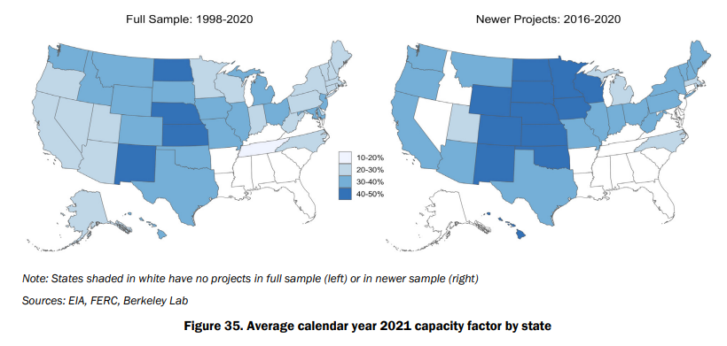
Capacity Factor by States
State and regional variations in capacity factors reflect the strength of the wind resource as capacity factors are highest in the central part of the country

Slide 22
What is Wind Curtailment?
Wind curtailment is the process of reducing or shutting down the output of wind turbines when the electricity demand is low or when the electricity grid is unable to absorb the available wind power.
Wind curtailment occurs when there is more wind power being generated than the grid can accommodate at a given time, which can lead to issues such as overloading of the transmission lines or instability in the grid. To prevent these problems, grid operators may curtail or reduce the output of wind turbines, which essentially means turning them off or reducing their output to a level that matches the available grid capacity.
This can push local wholesale power prices negative, thereby potentially triggering wind curtailment especially among projects not earning the PTC.
To reduce wind curtailment, grid operators and energy developers are exploring new technologies and strategies to better integrate wind power into the grid, including the use of energy storage systems and demand response programs that can better match the supply of wind power with the demand for electricity.

Slide 23
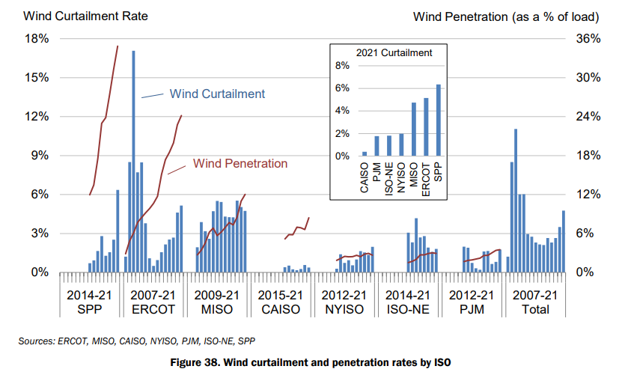
Wind Curtailment Rate
Wind curtailment seems to increase together with wind penetration.
In areas where curtailment has been particularly acute in the past, steps taken to address the issue have borne fruit. For example, just 0.5% of potential wind energy generation within ERCOT was curtailed in 2014, down sharply from 17% in 2009. This decline in curtailment corresponds to a significant build-out of new transmission serving West Texas, most of which was completed by the end of 2013. Since 2014, however, wind penetration has continued to increase in ERCOT, and so too has wind curtailment.

Slide 24
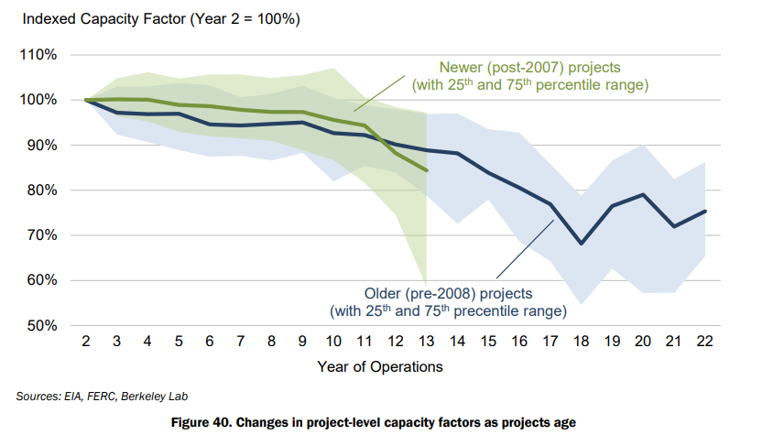
If wind turbine (and project) performance tends to degrade over time, then older projects—e.g., those built from 1998 to 2001—may have performed worse in 2021 than more recent projects simply due to their relative age.
Year two is chosen as the index base to reflect the initial production ramp-up period commonly experienced by wind projects as their operators work through and resolve initial “teething” issues during the first year of operations.
Overall, from year 15 to 20, average project performance appears to be roughly 75% of early-year performance

Slide 25
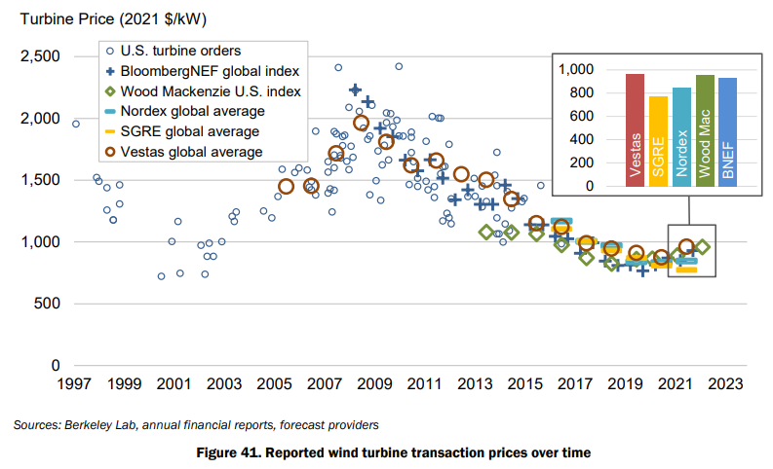
Cost of Wind Turbines
Wind turbine prices have dropped substantially since 2008, despite continued technological advancements that have yielded increases in hub heights and especially rotor diameters. However, with supply chain pressures and rising materials prices, turbine prices generally increased in 2021.

Slide 26
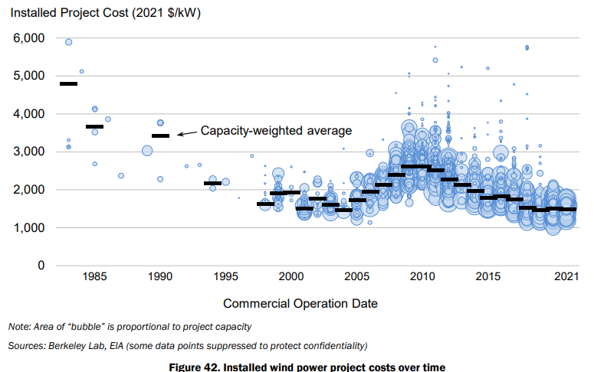
Installation Cost
The average installed costs of projects declined from the beginning of the U.S. wind industry in the 1980s through the early 2000s, and then increase, reflecting turbine price changes.
Costs peaked in 2009–2010. Though project-level costs have declined since 2010, they have largely held steady over the last few years—and with rising turbine prices may increase in the near term given the lag between turbine orders and project commissioning.

Slide 27
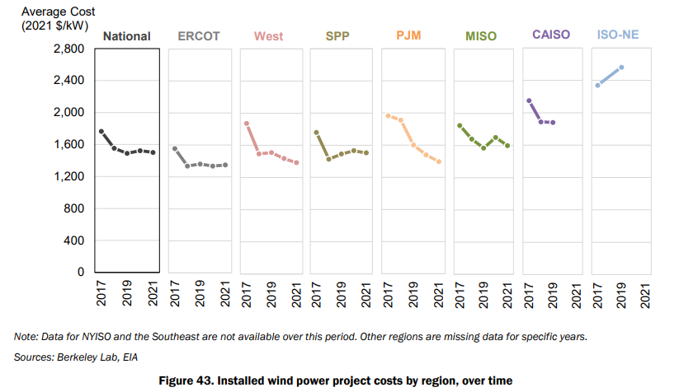
Installation Cost by Regions
Regional differences in average project costs are also apparent and may occur due to variations in labor costs, development costs, transportation costs, siting and permitting requirements and timeframes, and other balance of-plant and construction expenditures—as well as variations in average project size and the turbines deployed in different regions.

Slide 28
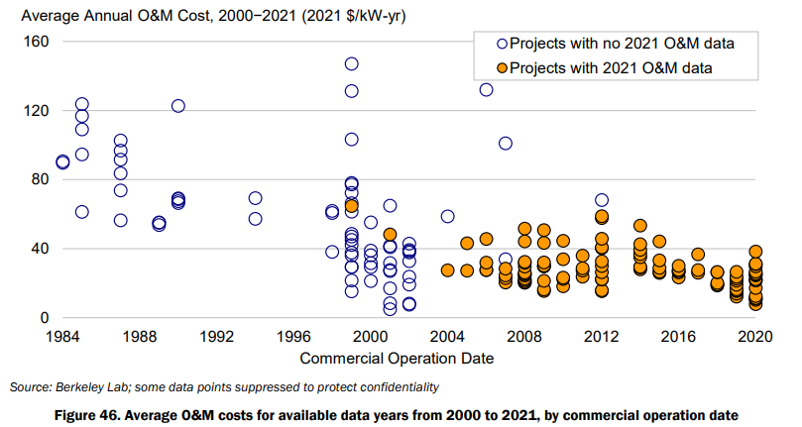
Operation and Maintenance Cost
The data demonstrate that O&M costs are far from uniform across projects.
It also suggests that projects installed in the past decade have, on average, incurred lower O&M costs than those installed earlier.
This decline may be due to at least two factors:
O&M costs generally increase as turbines age and component failures become more common;
projects installed more recently, with larger and more mature turbines and more sophisticated O&M practices, may experience lower overall O&M costs.

Slide 29
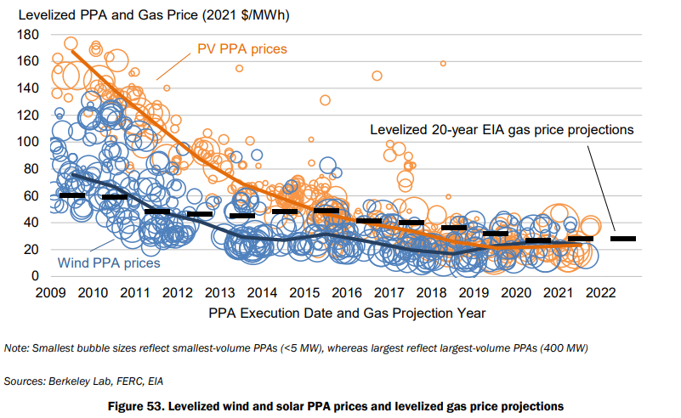
Cost and Value Comparison
wind PPA prices and utility-scale solar PPA prices—have, in many cases, been competitive with the projected fuel costs of gas-fired combined cycle generators. Specifically, the black dash markers show the 20-year levelized fuel costs—converted from natural gas to power terms.
Supported by federal tax incentives, the average levelized wind and solar PPA prices within this contract sample have, for several years now, been below the projected levelized cost of burning natural gas.
However, although the gap between wind and solar PPA prices was quite wide a decade ago, that gap has narrowed considerably in recent years, as solar prices have fallen more rapidly than wind prices

Slide 30
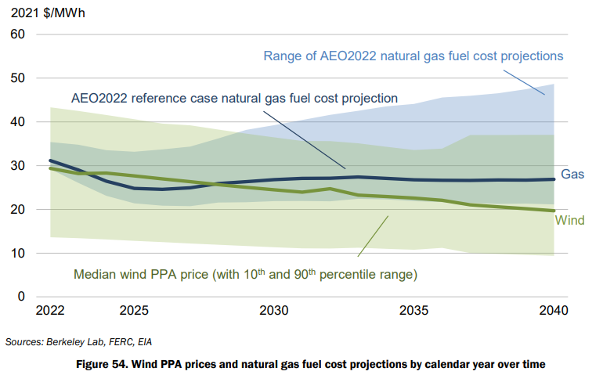
the long-term value that wind power might provide as a “hedge” against rising and/or uncertain natural gas prices. The wind PPA prices that are shown have been contractually locked in, whereas the fuel cost projections to which they are compared are highly uncertain. Actual fuel costs could ultimately be lower or higher. Either way, as evidenced by the widening range of fuel cost projections over time, it becomes increasingly difficult to forecast fuel costs with any accuracy as the term of the forecast increases

